Slide 1
Good form:
How Django’s form rendering improved during the 4.x series
David Smith

Slide 2



Introduction
David Smith
Maintainer of Django-crispy-forms
Contributor to Django since 2020
Member of Django’s Triage and Review team
smithdc1
@davidsmith@fosstodon.org

Slide 3
What are we going to cover?
Anatomy of a form
A walkthrough of new features added in the Django 4.x series
So, do I still need to use a 3rd party library?
What about the future?
Let’s go!

Slide 4
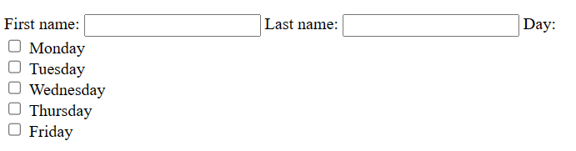
The anatomy of a form
Here’s an sample form, with it rendered in a template with `{{ form }}`
from django import forms
class ContactForm(forms.Form): first_name = forms.CharField() last_name = forms.CharField() day = forms.ChoiceField( choices=((1, "Monday"), (2, "Tuesday"), (3, "Wednesday"), (4, "Thursday"), (5, "Friday")), widget=forms.CheckboxSelectMultiple )
The whole form is rendered with all fields.
Notes:
3 mins

Slide 5
The anatomy of a form
A form can have many fields
class django import forms
class ContactForm(forms.Form): first_name = forms.CharField() last_name = forms.CharField() day = forms.ChoiceField( choices=((1, "Monday"), (2, "Tuesday"), (3, "Wednesday"), (4, "Thursday"), (5, "Friday")), widget=forms.CheckboxSelectMultiple )
Fields in the form become a `BoundField` in the template.
Notes:
Django’s definition of a BoundField is a field plus data.

Slide 6
The anatomy of a form
Each Field has a “widget”. A widget is Django’s representation on an HTML `<input>` element.
class django import forms
class ContactForm(forms.Form): first_name = forms.CharField() last_name = forms.CharField() day = forms.ChoiceField( choices=((1, "Monday"), (2, "Tuesday"), (3, "Wednesday"), (4, "Thursday"), (5, "Friday")), widget=forms.CheckboxSelectMultiple )
Widget: HTML input element
Note: Choice widgets, have “subwidgets” for each option

Slide 7
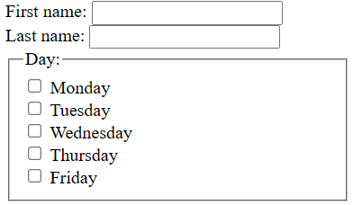
The as_* methods
Historically Django has provided 3 “as_*” methods to allow for customisation of the form layout.
as_table (the default).
as_ul
as_p
New `as_div` template in Django 4.1 with improved accessibility which is easier for screen reader users to navigate.
New in Django 4.1
Notes:
`as_div` implements `<fieldset>` and `<legend>` to group related inputs.

Slide 8
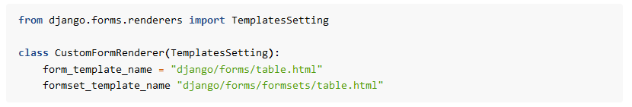
New as_div template
`as_div` will become the default from Django 5.0.
Transitional renderer to switch early:
To retain previous behaviour:
New in Django 4.1
New in Django 4.1

Slide 9
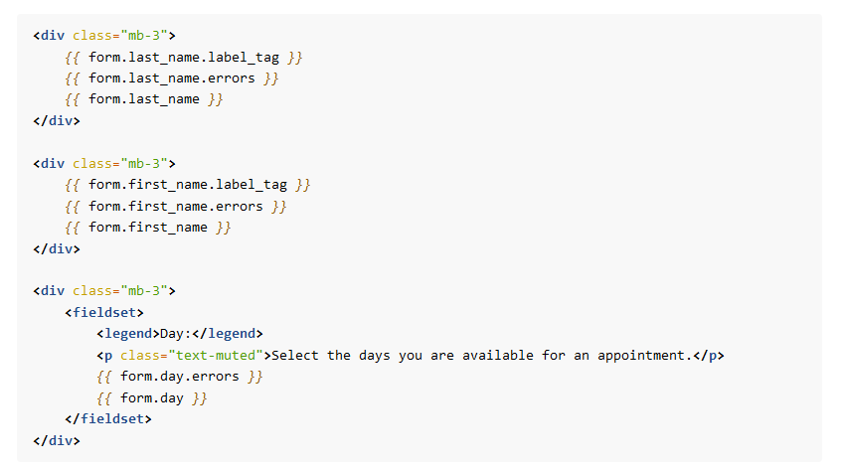
That’s great, but it doesn’t look very pretty?
Forms can be unpacked to access fields and their elements.
But!
This can be much more verbose, ideally we’d just like to write {{ form }}. Let’s see how we can improve this.
Notes:
10 mins

Slide 10
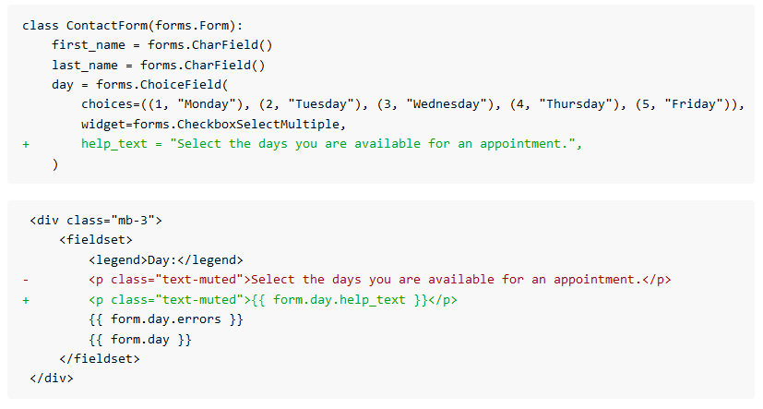
Move items to the Field definitions.
Use field arguments, such as `help_text` and `label`.

Slide 11
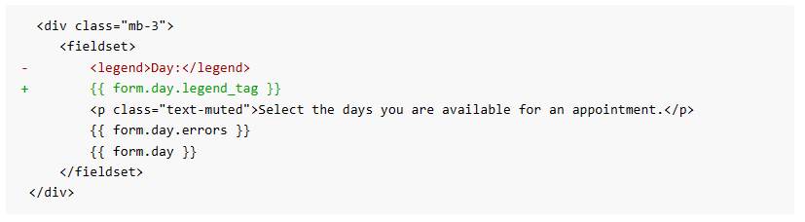
Legends
Use `legend_tag`
New in Django 4.1

Slide 12
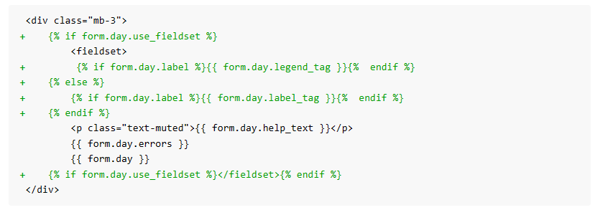
Fieldsets
BoundField also learnt `use_fieldset`
New in Django 4.1

Slide 13
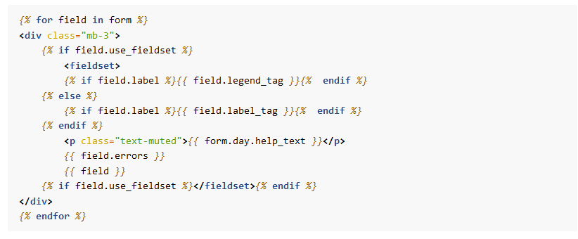
The result!
Loop over each field in the form and use this generalised
Tip:
Use `field_order` on the form to order the fields.

Slide 14
The switch to use template based rendering for forms.
While we’ve now got a shorter template code we still need to include this code in the main template. Rather we’d just like to write `{{ form }}`.
1. Extract code to a form template. E.g. “form_template.html”
2. Set `template_name` on your form class. Ensure the template loader can find the template.
New in Django 4.0

Slide 15
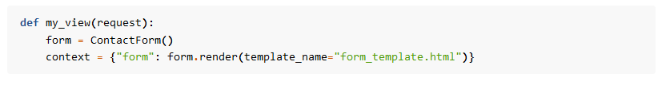
Per-instance templates
Call `render()` on your form in a view and providing a `template_name` to customise the template per instance.
New in Django 4.0

Slide 16
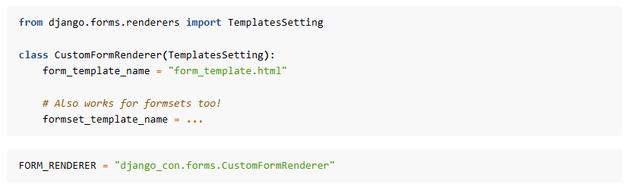
Site wide setting
Use `FORM_RENDER` setting to use the template site wide
New in Django 4.1
Benefits are:
Allows for templates to be simplified, can just call {{ form }}.
Can write one form template for your site and use it for every form.
Per-form customisation using a form specific `template_name`.
Notes:
18 mins

Slide 17
Review of form design
Move as much logic from the template to the form as possible. E.g. help text
Use new features to ease writing of template logic. `legend_tag`, `use_fieldset`
Loop over fields in the template, to reduce repetition.
Set form template at per project, per form or per instance.
Finally:
Templates are also available for:
Labels via `template_name_label` on your `Form`
Errors via a custom `error_class` on your `Form`

Slide 18
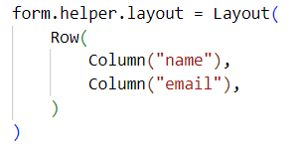
So, do I still need a 3rd party library?
It depends!
Crispy-forms has the following features:
Flexible form layouts with the `Layout` class:
Dynamic form layouts.
Updating attributes. `form.helper[0:3].update_attributes(css_class=“hello”)`
Filtering by widget. `form.helper.filter_by_widget(forms.PasswordInput).wrap(Field, css_class="hero")`
Template packs, with custom layout objects.
Modals
Floating Fields
Alerts

Slide 19
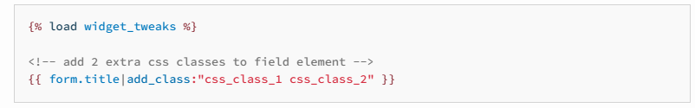
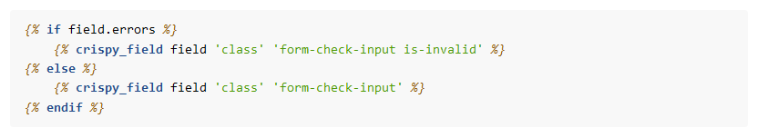
So, do I still need a 3rd party library?
Django-crispy-forms and django-widget-tweaks both allow adding css classes in templates.
django-widget-tweaks
django-crispy-forms

Slide 20
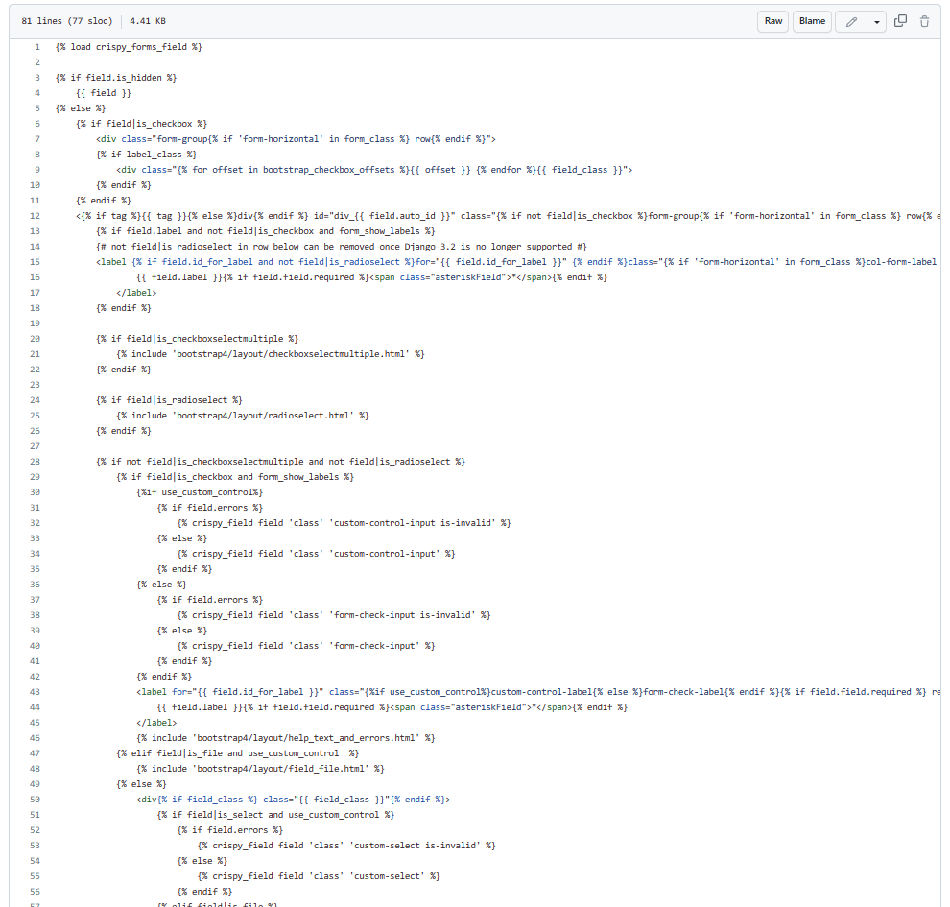
So, do I still need a 3rd party library?
Crispy-forms template logic can be complex.
Here’s the core `field.html` template.
This doesn’t even cover checkboxes, radios and file fields!

Slide 21
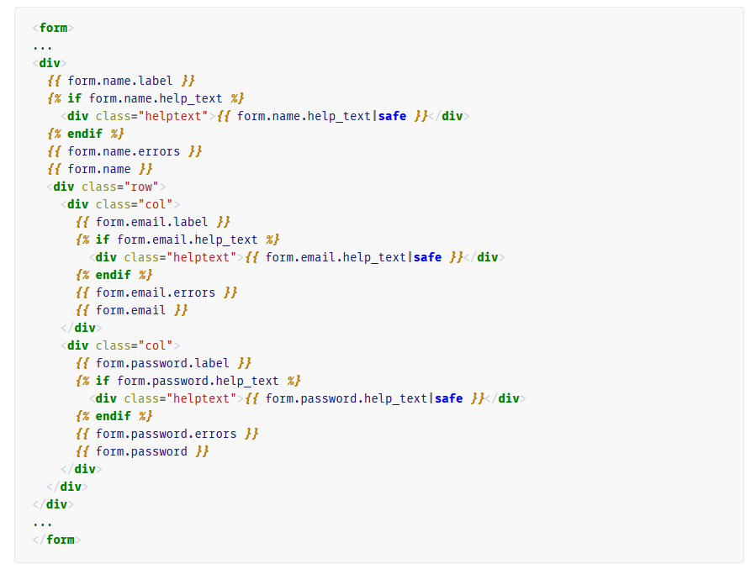
What about the future?
Simplified templates for form field rendering
Say, you are asked to add two of the form fields on the same row. Currently you’ll need to write something like this.
Notes:
26mins

Slide 22
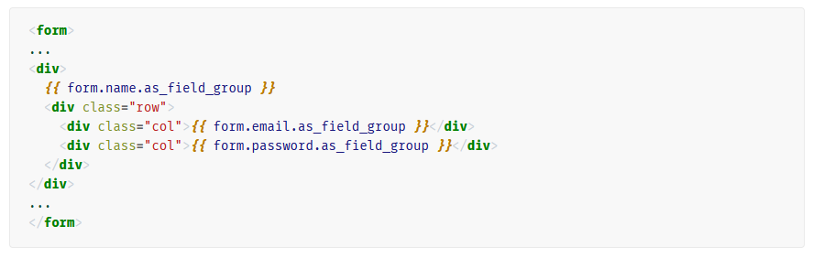
What about the future?
Simplified templates for form field rendering
Let’s allow `BoundField` to be renderable with its own template. Then we can write something like.
This feature is coming in Django 5.0. Templates can be defined
Per-project, by defining “field_template_name” on your FORM_RENDERER
Per-field, fields learnt a new “template_name” argument.
Anything else?
{{ form.field }} rendering the widget, not the field. But! It’s been like this _forever_ 🤷

Slide 23
Thank you!

